Slide 1
BOB- MICROSOFT AUTOMATED CHEQUE PROCESSING
Sourabh Kumar Janghel

Slide 2
HELLO!
I am Sourabh Kumar Janghel
This Presentation contains detailed representation of the POC submitted at Techgig for BOB Hackathon .
You can find me at sourabh.kumar.janghel@outlook.com

Slide 3
Description Of Solution
1
Description of what the Team has tried to build

Slide 4
THE BIG IMPACT.
WEB UPLOAD
A web app to upload your cheques – Upload View to Azure
OPTMIZATION
Whitespace and DPI optimization before uploading and processing cheque – Bandwidth saving
EXTRACTION
Extract the Cheque Entitles and create a structure response - Extraction of Information
TRANSLATION
Detecting Language and converting the text to English. Translation to ENG
MASKING
Masking the sensitive information in the cheque after process completion –Masking entities
DB
Upload the generated results to azure DB and integrate to downstream applications - Storing

Slide 5
PROCESS
Upload document to website
Detect cheque Orientation
Categorize extracted data into entities, structured and unstructured data
Verify signature using the signature stored
Mask Data for KYC’s identified documents
Upload to azure blob storage
1
2
3
4
5
6
7
8
9
10
11
12
Identify document type (PDF/Image)
Optimize image for white space and DPI with Quality intact
Extract data from Azure form recognizer either using the custom trained ones or a general one
Identify signature using azure data extracted
Translated text if require by detecting language
Upload the JSON data created to Azure cosmos DB

Slide 6
Architecture
2
High-level implementation / Solution diagram

Slide 7
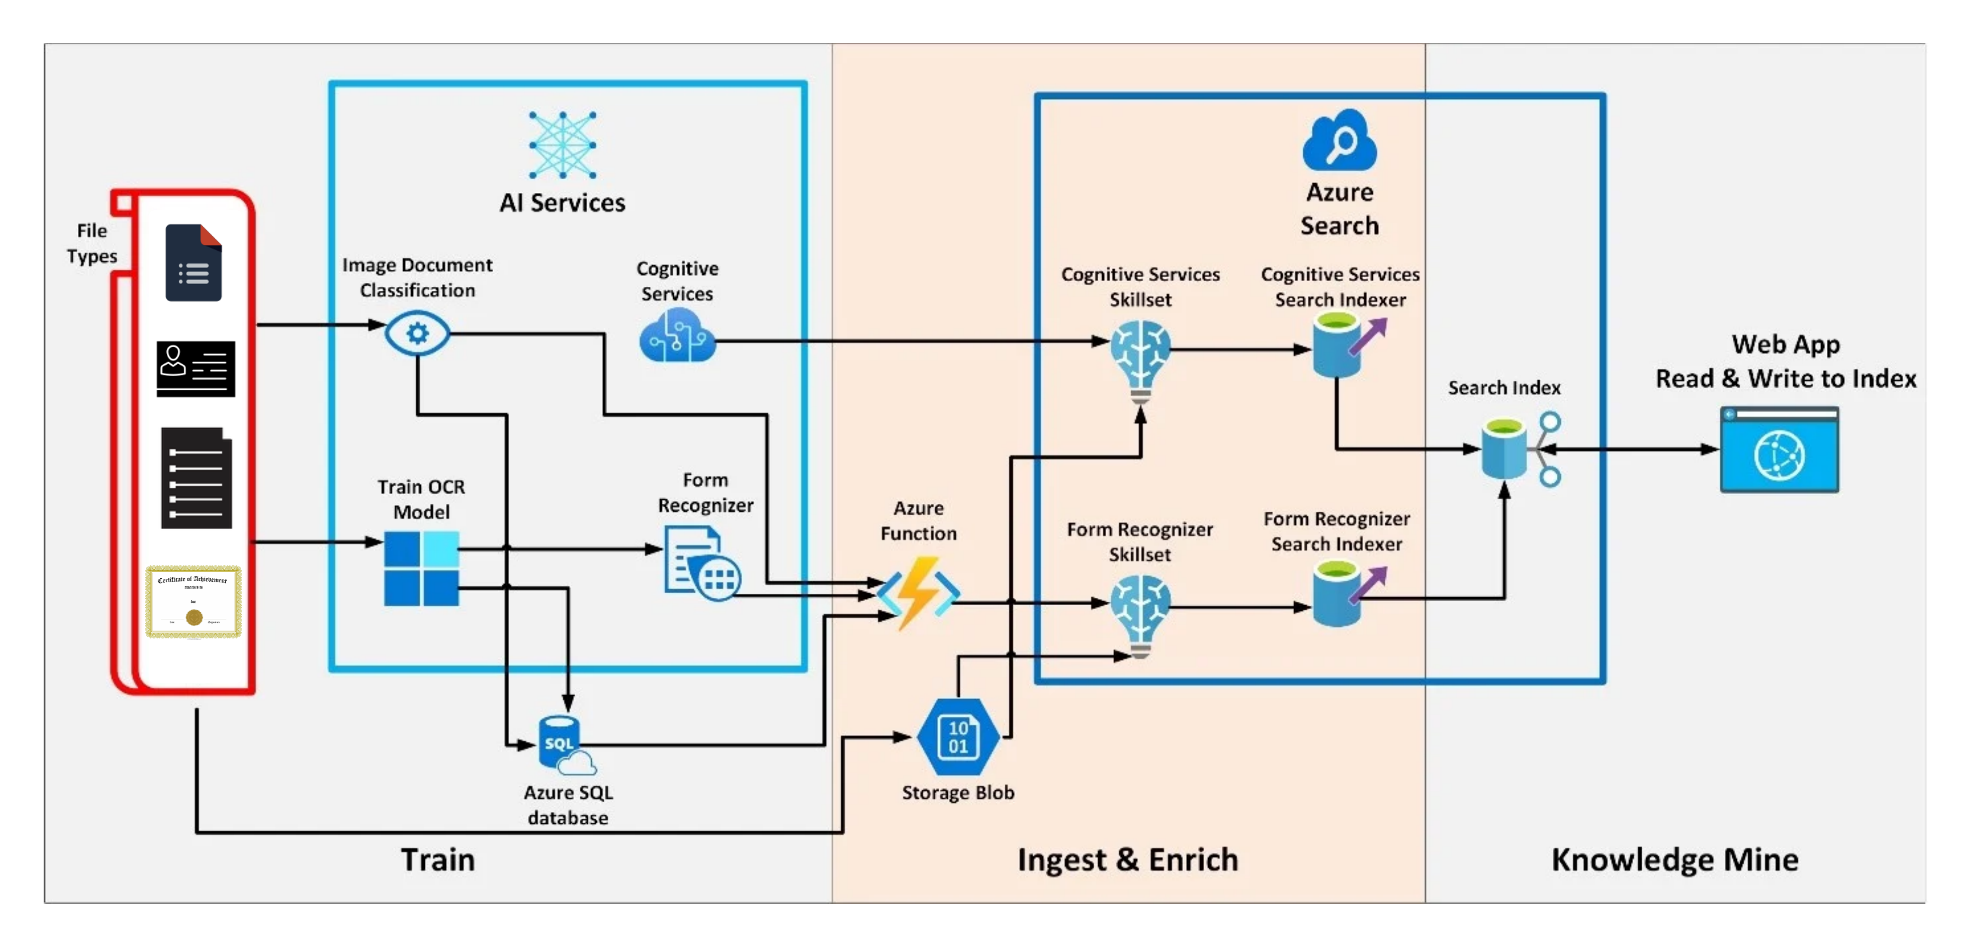

Slide 8
Tech Stack
3
Tools, Technology Stack (including the APIs consumed), and framework details

Slide 9
TECH STACK ANALYSIS
Tools
Python 3.9
APIs
Azure App Service
Azure Form Recognizer
Azure Translator
Azure Containers
Azure Cosmos DB
Storage
Tensorflow
Torch
Framework

Slide 10
Algorithms
4
The algorithms / machine learning models that have been used in the Hackathon prototype

Slide 11
USED Algorithms
ImageHash
Yolo v5
pdf2image
signature-detect
numpy
opencv-python
Pillow
imutils
tqdm
azure-formrecognizer
azure-computervision
azure-translator
azure-storage-blob

Slide 12
Video Demo
Please Find the Link of the video here.

Slide 13
Output
5
Test cases and corresponding processed output file(s) along with the output time

Slide 14

A PICTURE IS WORTH A THOUSAND WORDS
A complex idea can be conveyed with just a single still image.
Namely making it possible to absorb large amounts of data quickly.

Slide 15
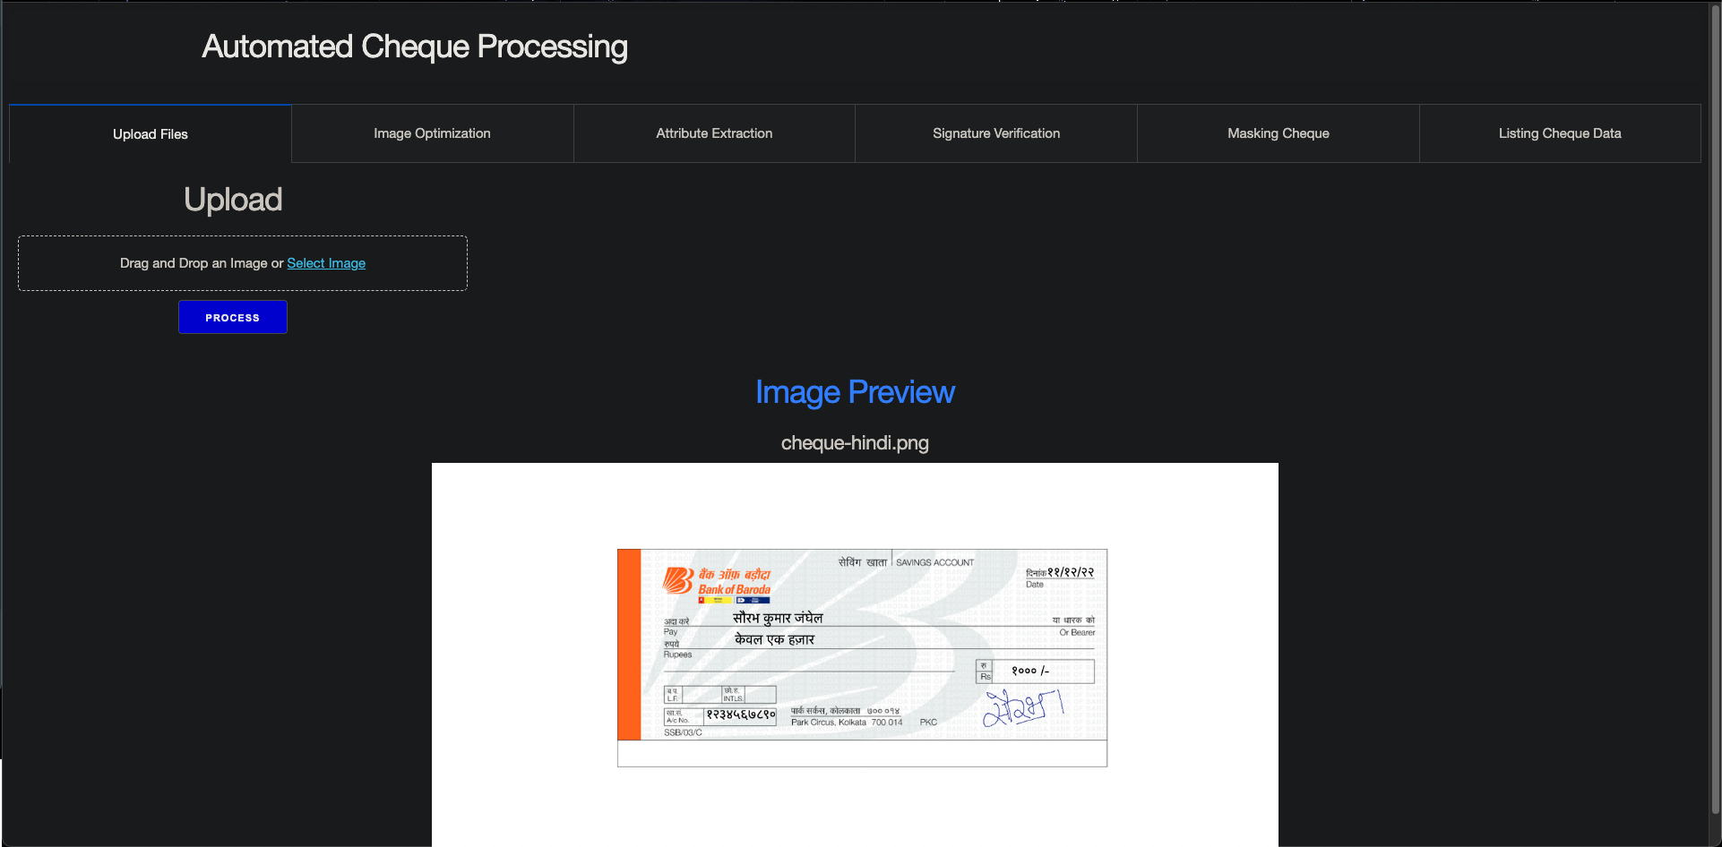
Upload

Slide 16
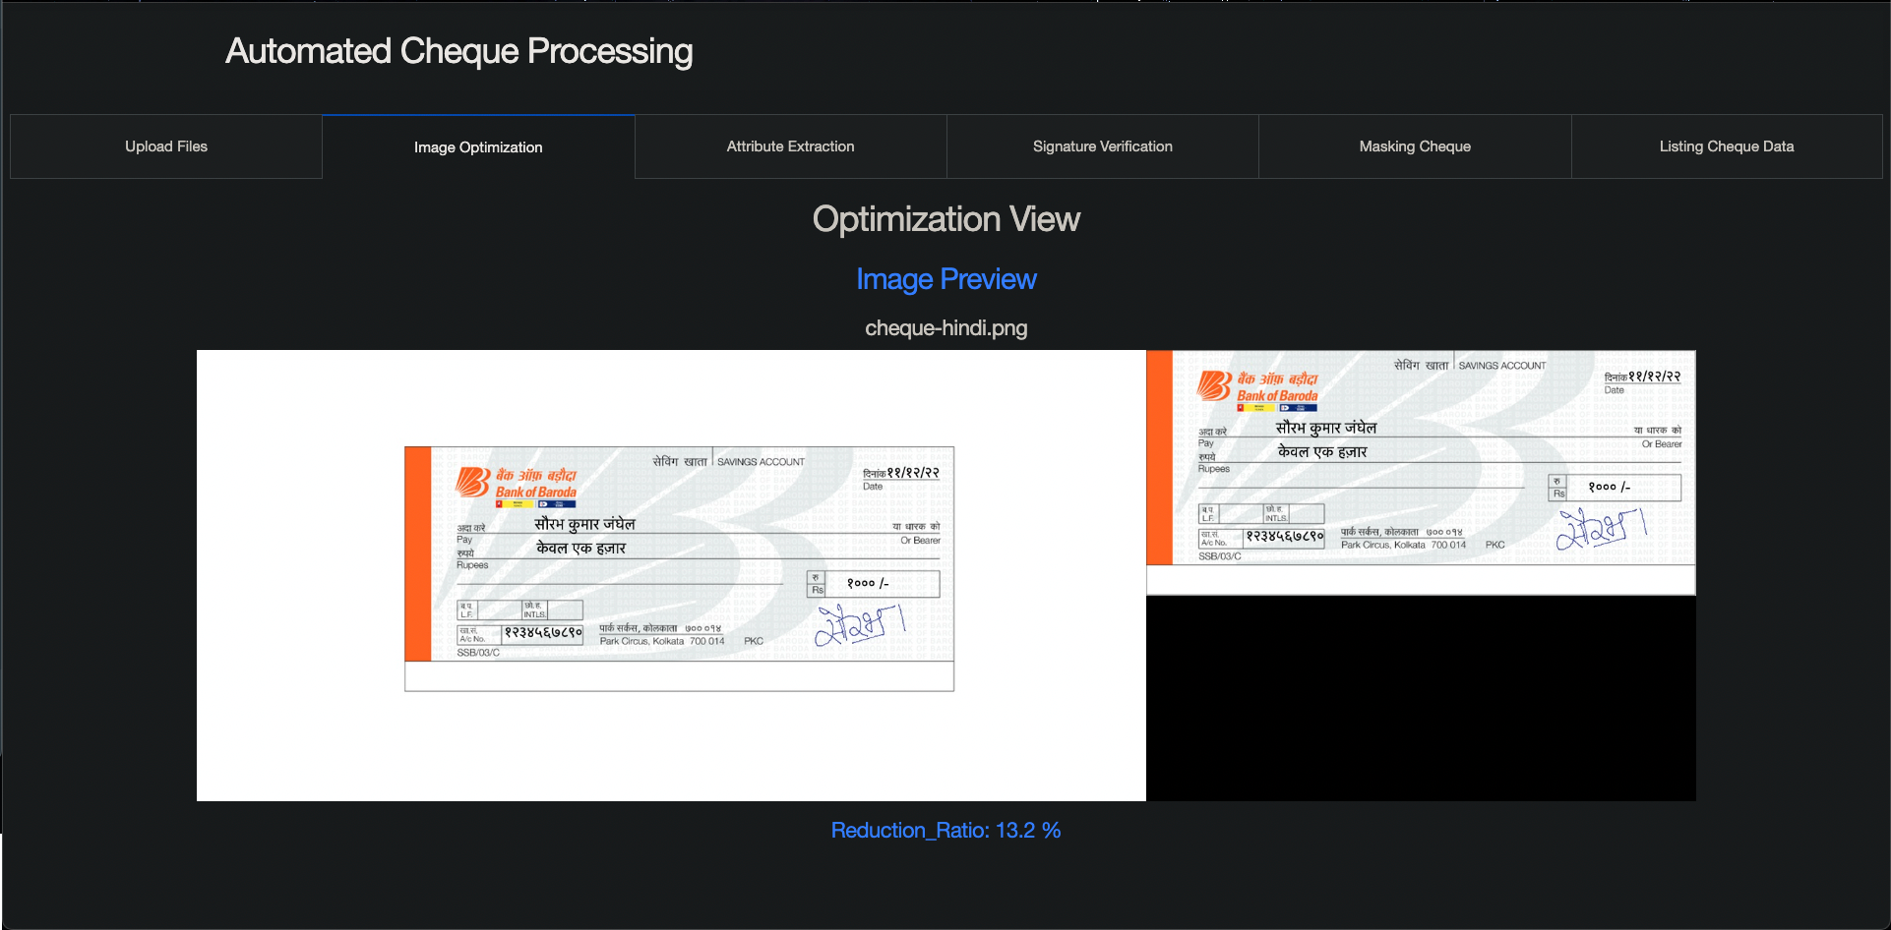
Optimization

Slide 17
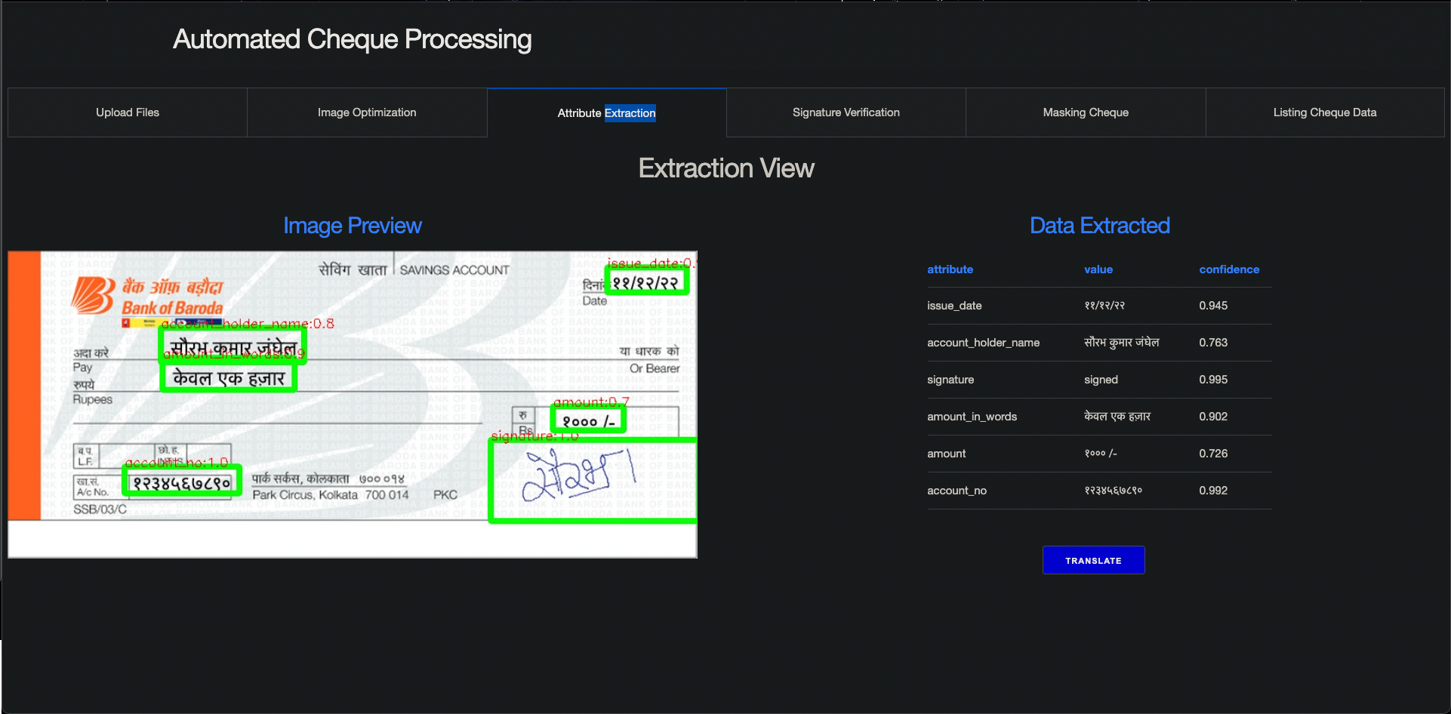
Extraction

Slide 18

Translation

Slide 19
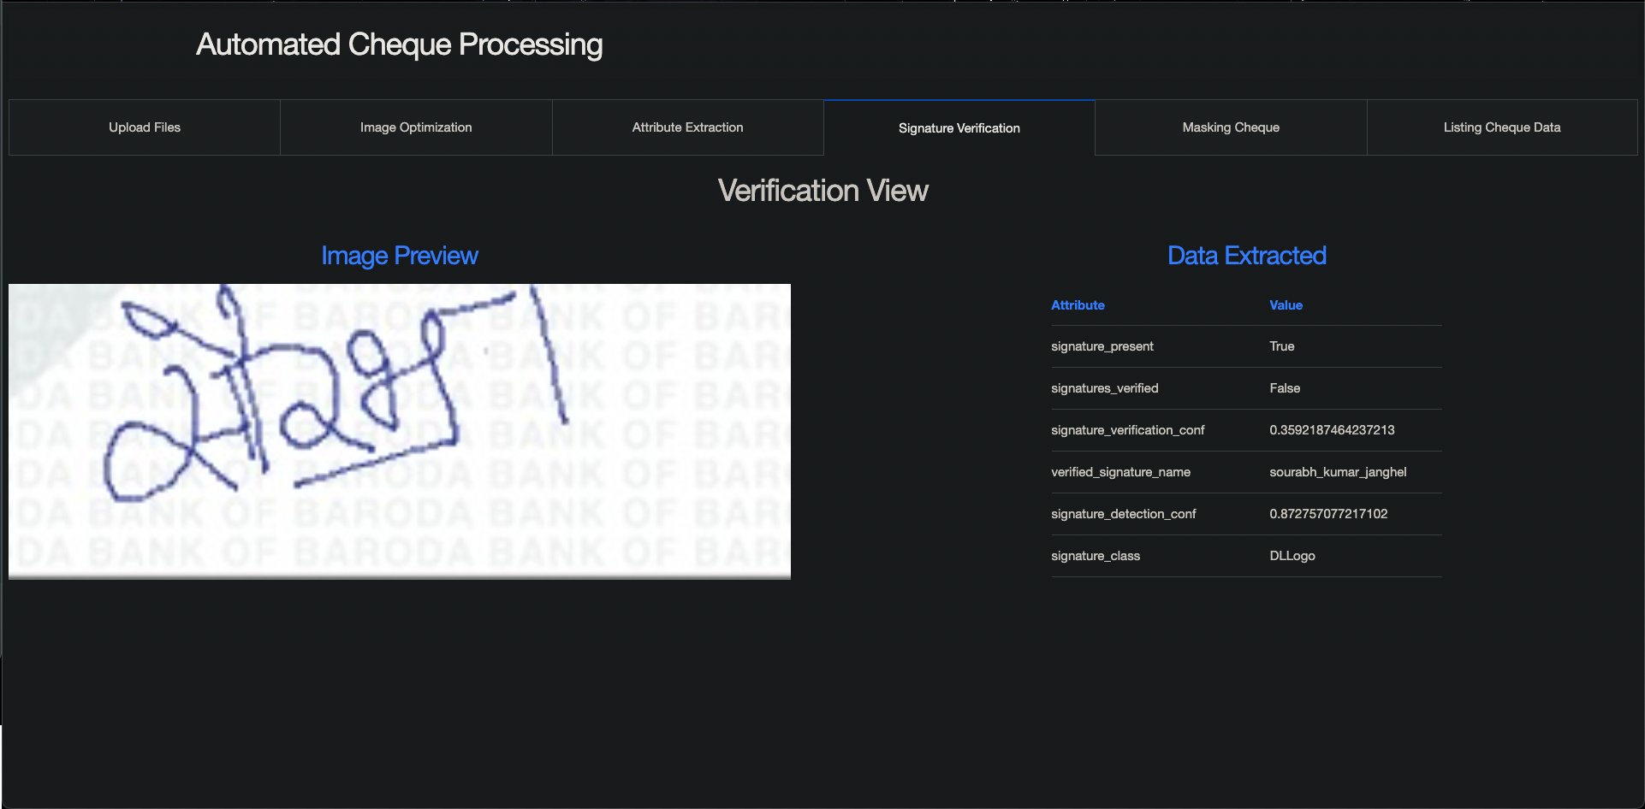
Signature

Slide 20
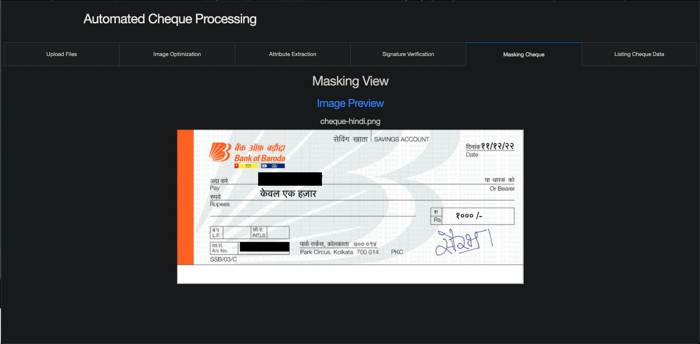
Masking

Slide 21
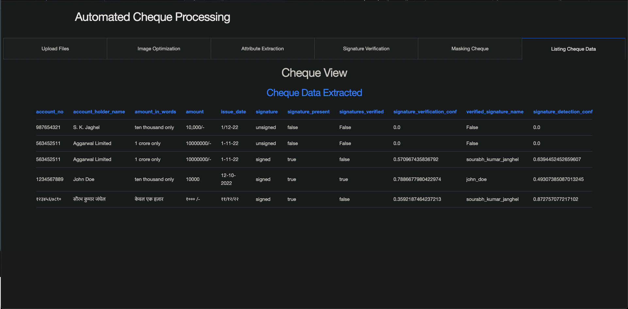
DATA VIEW

Slide 22
Summary
6
A write-up on why your application /solution should be considered

Slide 23
Why the solution should be considered?
The below points can be considered for my submission:
A UI added to make the process of processing cheque easier which can be integrated with downstream systems.
Works well for Both Handwritten and Printed Images which contains noise.
Custom Processor Models to extract structured and unstructured text from the cheque(Azure Computer Vision OCR) without large datasets with good confidence.
Signature Identification and Verification using custom model and azure form recognizers with a custom YOLO v5 trained model on signature dataset with VGG vectors along with distance matching to verify signatures.
Azure Web Apps for hosting and running solution [Auto Scaling]
Azure language translation layer to detect and translate languages.
Masking of text from cheques to hide sensitive data after processing.
Azure Containers to store documents/images.

Slide 24
Scaling
7
Ability to scale-up in enterprise grade environment

Slide 25
The Solution Can be dockerised and deployed as a HTTP Azure function or a Web App in azure
AZURE Functions
100% Scalable
That’s a easy serverless way of running the solution on cloud
instances of the Functions host are dynamically added and removed based on the number of incoming events.
Automatically scales based on demand using pre-warmed workers, which run applications with no delay after being idle, runs on more powerful instances, and connects to virtual networks
Total success!

Slide 26
Deployment
7
Ability to deploy in any environment

Slide 27
The Solution Can be dockerised and deployed in any hosting
Cloud & On-Premise
100% Portable
It can be hosted in both -
If we opt for an on-premise solution or a private cloud we will need to custom create the translation models and entity ex traction models.
For cloud if we shift to any cloud we can plug and play with the cloud offering services.
Total success!

Slide 28
Building Efforts
7
How does the prototyping timeline looks like?

Slide 29
GANTT CHART
 | Week 1 |  |  |  |  |  |  | Week 2
 | 1 | 2 | 3 | 4 | 5 | 6 | 7 | 8 | 9 | 10 | 11 | 12 | 13 | 14
Dash UI Task 1
Backend Coding Task 2 |  |  |  |  |  | ◆
Data Storage Task 3
Integration Task 4 |  |  |  |  |  |  |  |  |  |  | ◆
Testing Task 5 |  |  |  |  |  |  |  |  | ◆
Deployment Task 6
Custom model Task 7
Demo Task 8

Slide 30
Hard Questions & Post Hackthon
7
Ability to deploy in any environment

Slide 31
SWOT ANALYSIS
STRENGTHS
The solution consists of all the necessary step required for automation and has a good confidence score
WEAKNESSES
If we have to use the solution without cloud there would be significant dev efforts required and the performance KPIs will change
S
W
The solution can be used to replace the ongoing manual efforts and reduce cost.
OPPORTUNITIES
The cloud dependency for fin-tech solution is what needs to be explored in terms of encryption and security.
THREATS
O
T

Slide 32
THANKS!
Any questions?
You can find me at
Email@sourabh.kumar.janghel@outlook.com
LinkedIn@sourabhkumarjanghel

